Slide 1

PostgreSQL Basic: Unlock the Power of the World's Most Advanced Open-Source Database​

Slide 2
Overview​
​Welcome to this comprehensive overview of PostgreSQL and how to use it with pgAdmin. Discover the amazing features and learn how to set up and manage databases with ease. we will explore the importance of PostgreSQL, dive into its key features, and learn how to perform basic SQL operations using pgAdmin.
Notes:
2

Slide 3
What is PostgreSQL?
PostgreSQL is an advanced open-source relational database management system known for its stability, scalability, and extensive features. It provides a robust foundation for data-driven applications.​
Notes:
3

Slide 4
Features of PostgreSQL
Relational Database
Extensibility​
PostgreSQL offers full support for tables, relationships, and SQL queries, making it ideal for managing structured data.​
With support for custom data types, functions, and extensions, PostgreSQL allows developers to tailor the database to their specific needs.​
Data Integrity​
PostgreSQL ensures data integrity with features such as constraints, triggers, and transactions, ensuring reliable and accurate data.​
Notes:
4

Slide 5
How to install & set up?
Download the PostgreSQL installer from the official website.​
Run the installer and follow the on-screen instructions to complete the installation.
Configure the installation settings, including the database superuser password and port number.
Start the PostgreSQL service and verify the successful installation.
Ref. Link
https://www.postgresql.org/download/
https://www.postgresqltutorial.com/postgresql-getting-started/install-postgresql/
Notes:
5

Slide 6
Introduction to pgAdmin
pgAdmin is a popular administration and development platform for Postgresql. It provides a user-friendly interface to manage databases, execute queries, and perform various administrative tasks.
Notes:
6

Slide 7
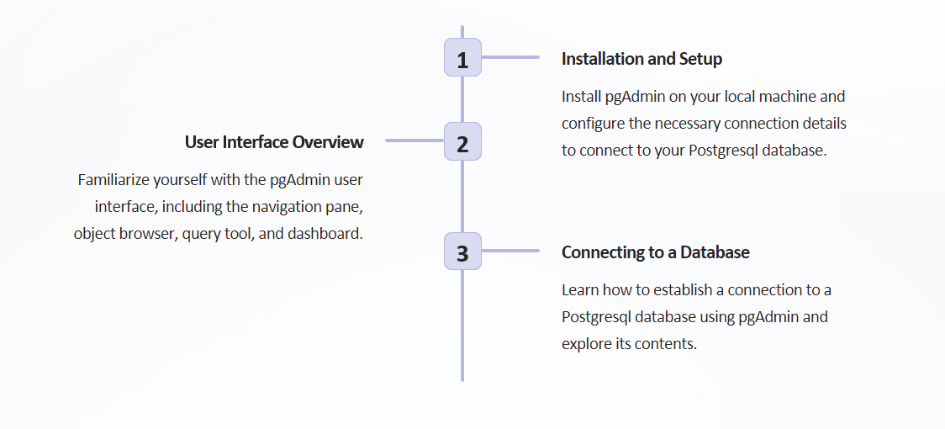
Getting Started with pgAdmin
Notes:
7

Slide 8
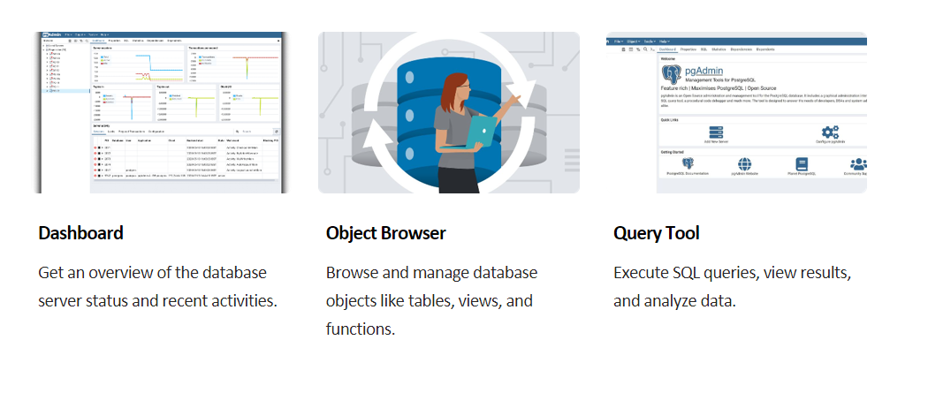
Navigating pgAdmin
Notes:
8

Slide 9
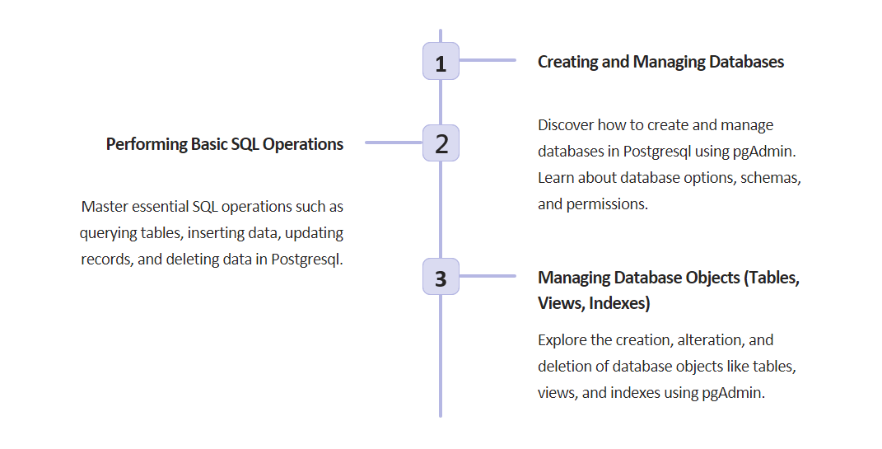
Working with Postgresql and pgAdmin
Notes:
9

Slide 10
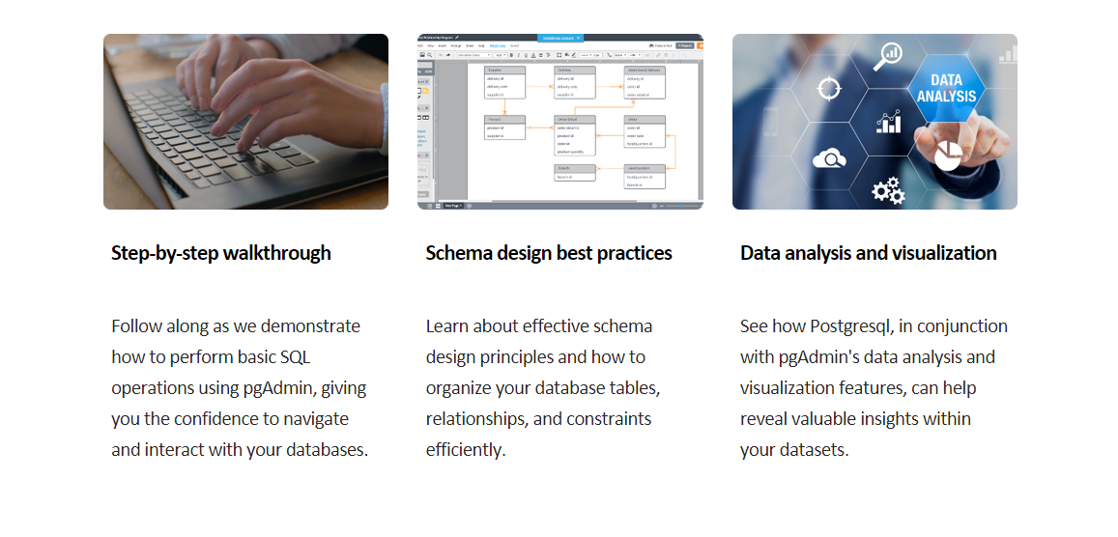
Hands-on demo with pgAdmin
Notes:
10

Slide 11
How to Create Database
How to use the PostgreSQL CREATE DATABASE statement to create new databases in the PostgreSQL database server.
Using Query
CREATE DATABASE database_name
Using pgAdmin
The pgAdmin tool provides you with an intuitive interface for creating a new database. First, log in to the PostgreSQL database server using pgAdmin. Second, right-click the Databases node and select Create > Database… menu item
Notes:
11

Slide 12
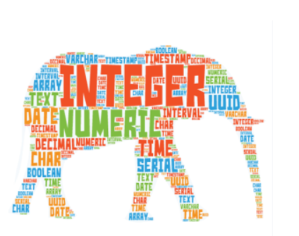
PostgreSQL Data Types
PostgreSQL data types including Boolean, character, numeric, array, json, uuid, and special types.
Boolean for storing true and false value
Character types such as char, varchar, and text.
Numeric types such as integer and floating-point number.
UUID for storing Universally Unique Identifiers
Array for storing array strings, numbers, etc.
JSON stores JSON data
Notes:
12

Slide 13
Understanding PostgreSQL Constraints
Primary key – How to define a primary key when creating a table or adding a primary key to an existing table.
Foreign key – show you how to define foreign key constraints when creating a new table or add foreign key constraints for existing tables.
UNIQUE constraint – make sure that values in a column or a group of columns are unique across the table.
NOT NULL constraint – ensure values in a column are not NULL.
CHECK constraint – add logic to check value based on a Boolean expression.
Notes:
13

Slide 14
How to Create Table
A relational database consists of multiple related tables. A table consists of rows and columns. Tables allow you to store structured data like customers, products, employees, etc. To create a new table, you use the CREATE TABLE statement. The following illustrates the basic syntax of the CREATE TABLE statement:
CREATE TABLE [IF NOT EXISTS] table_name (
column1 datatype(length) column_contraint,
column2 datatype(length) column_contraint,
column3 datatype(length) column_contraint,
table_constraints
);
Notes:
14

Slide 15
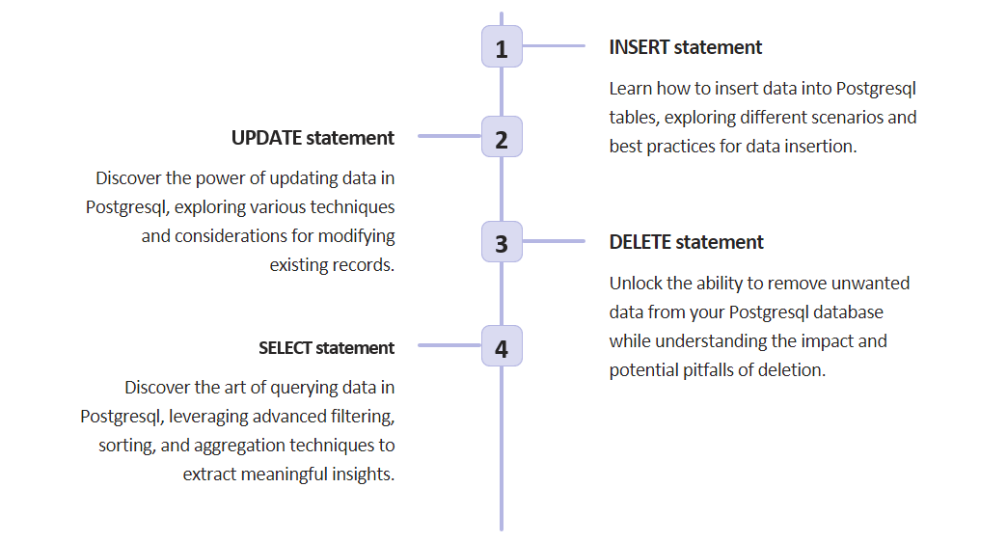
Performing Basic Operations with PostgreSQL
Notes:
15

Slide 16
Querying Data
Select
Column aliases – Assign temporary names to columns or expressions in a query. (select lastname AS surname)
Order By – Sort the result set returned from a query.
Select Distinct – Removes duplicate rows in the result set.
Notes:
16

Slide 17
Filtering Data
Where – filter rows based on a specified condition.
Limit – get a subset of rows generated by a query.
Fetch – limit the number of rows returned by a query.
In – select data that matches any value in a list of values.
Between – select data that is a range of values.
Like – filter data based on pattern matching.
Is Null – check if a value is null or not.
Notes:
17

Slide 18
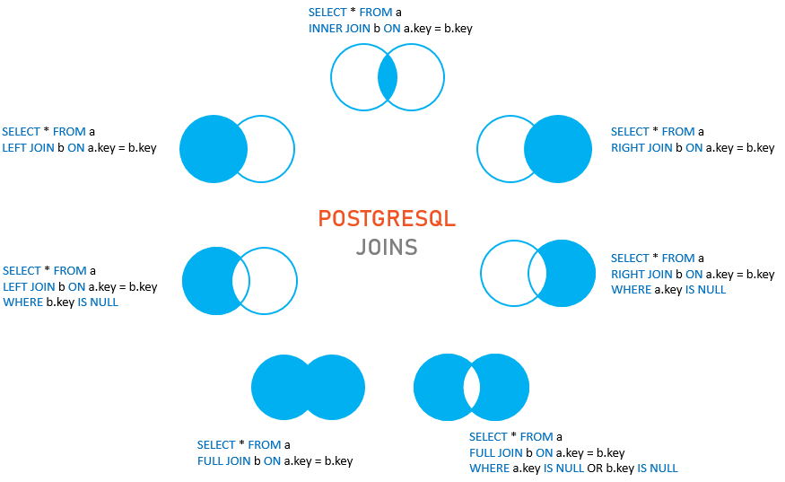
Joins
Notes:
18

Slide 19
Grouping Data
Group By – divide rows into groups and apply an aggregate function on each.
Having – apply conditions to groups.
SELECT
column_1,
column_2,
aggregate_function(column_3)
FROM
table_name
GROUP BY
column_1,
column_2,
SELECT
column1,
aggregate_function(column2)
FROM
table_name
GROUP BY
column1
HAVING
condition;
Notes:
19

Slide 20
Sub Query
Subquery – write a query nested inside another query.
ANY – retrieve data by comparing a value with a set of values returned by a subquery.
ALL – query data by comparing a value with a list of values returned by a subquery.
EXISTS – check for the existence of rows returned by a subquery
Notes:
20

Slide 21
THANK YOU
ANY QUESTIONS ?
Notes:
21

